Slide 1

Predicting Marketing Response Rates
Thinkful Data Science Mid-Capstone
Roy Shabaya

Slide 2
Introduction
Data
Marketing response data obtained from UCI Machine Learning Repository - Portuguese bank using telemarketing to offer their customers a term deposit product
Data includes demographic information on the customer, the banks information on the campaign, as well as macro-economic data
Research Topic: Can we predict whether a customer will purchase the product, given demographic, campaign, and economic data.
Purpose: Being able to predict a customers response to a marketing campaign can help a company maximize their marketing efforts

Slide 3
Data Exploration – Initial Insights
Baseline 88.8% of the data is from the majority class, customers that did not make a purchase
There are 41,188 observations, across 21 features
3 Sections of Data:
Customer – Age, Job, Marital, Education, Housing, etc. (1/8 numerical)
Campaign – Number of contacts, day of week, duration, previous outcomes (4/8 numerical)
Macro Economic – CPI, Employment variation rate, CCI, Number of employees( 5/5 numerical)

Slide 4
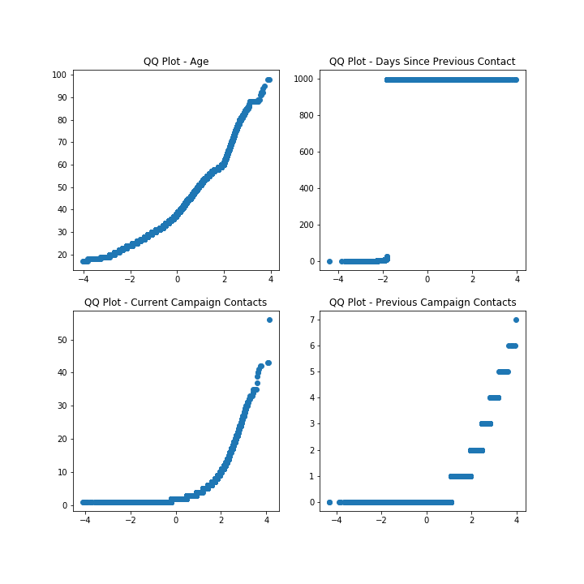
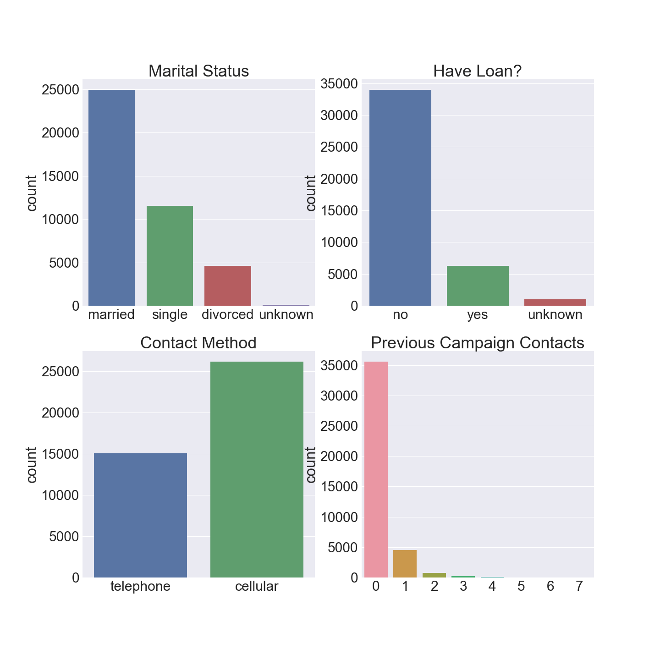
Exploring the Data…
Numerical
Categorical

Slide 5
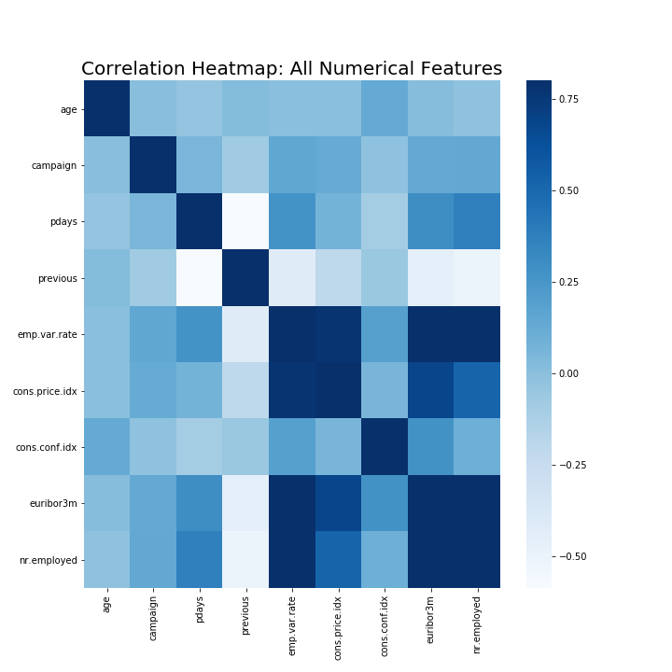
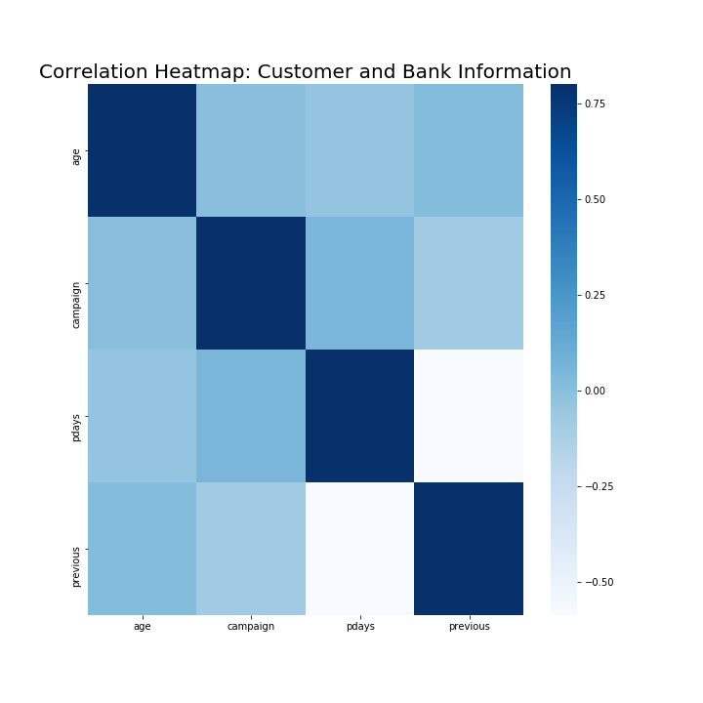
Feature Correlation
Looking a the full data set we can see high correlation between the macroeconomic features.
Previous and pdays are negatively correlated due a coding quirk, if a customer has not been previously correlated pdays has a value of 999, while previous has 0. Apart from that the features appear independent.

Slide 6
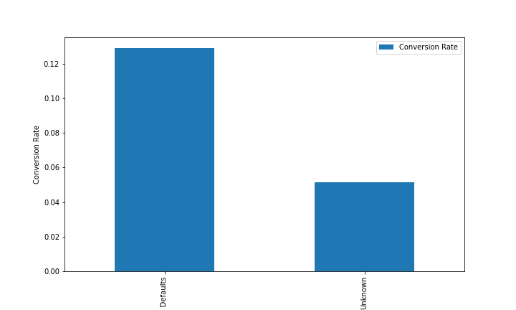
Conversion Rate : Past Defaults

Slide 7
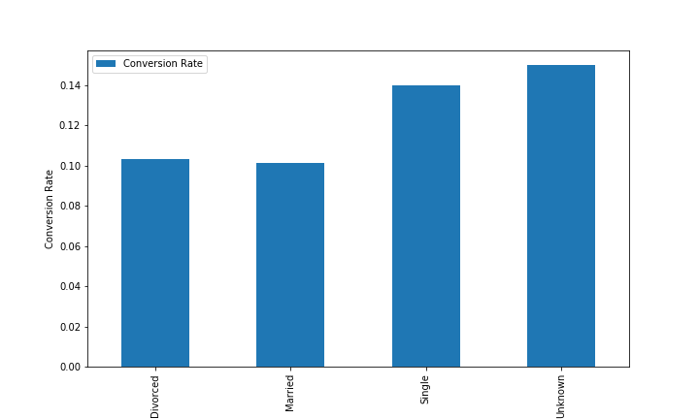
Conversion Rate : Marital Status

Slide 8
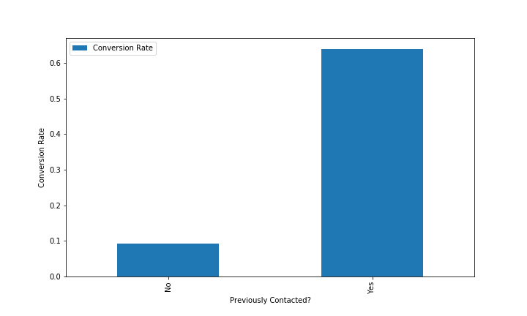
Conversion Rate :

Slide 9
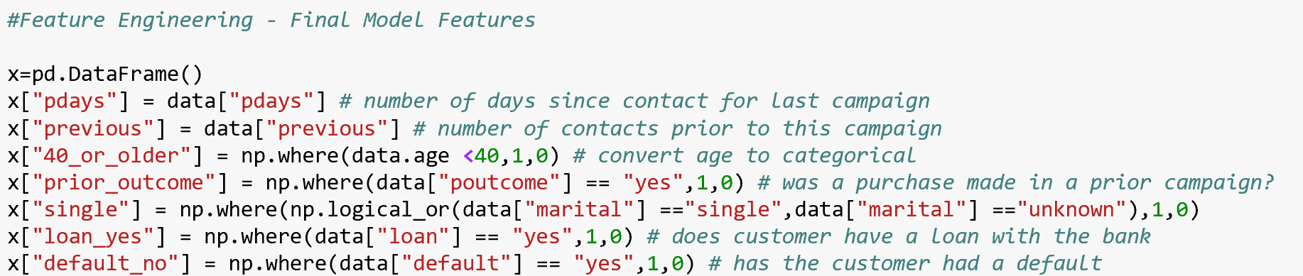
Feature Engineering
Created features based on insights learned from exploration
Most of the customer and bank data was categorical – created dummy features
Attempted to identify interactions, as well as whether transformations would help performance
Transformed several continuous variables to categorical

Slide 10
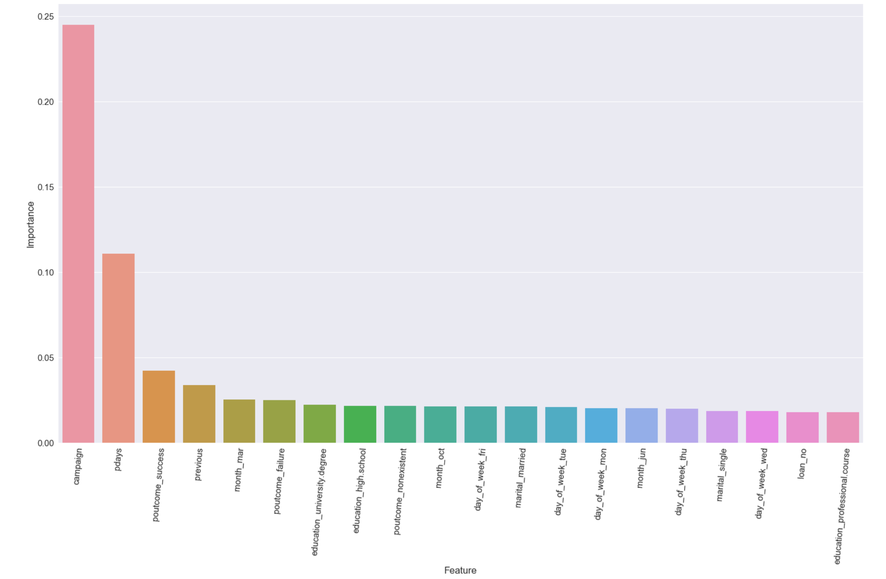
Feature Selection
Several methods were used for feature selection:
Coefficients from Lasso
PCA
Random Forest Feature Importance
Backwards Pass Feature Elimination
RFE
Conclusion – Most features don’t improve model

Slide 11

Measuring Model Performance
Sensitivity
Specificity
Probability that positive examples will be correctly identified
Customer making a purchase is our positive
Probability that negative examples will be correctly identified
Customers that don’t make a purchase are the negative
Accuracy
Mean accuracy of the overall model
Built in method for all models

Slide 12
Modeling
No models were able to able to product significantly better results than the baseline of 88.8%
The best accuracy performer was KNN
The best performers measured by specificity were Lasso and Ridge Regression
Results
Model | Train Score | Test Score | Specificity | Sensitivity
KNN | 0.8985 | 0.8962 | 0.9874 | 0.1944
Random Forest | 0.9007 | 0.8961 | 0.9894 | 0.1775
Boosted Model | 0.9002 | 0.8954 | 0.9871 | 0.1893
Standard Logistic | 0.8983 | 0.8953 | 0.9844 | 0.2088
Support Vector | 0.8983 | 0.8953 | 0.9844 | 0.2088
Lasso Regression | 0.8221 | 0.8214 | 0.8878 | 0.3102
Ridge Regression | 0.8221 | 0.8214 | 0.8878 | 0.3102

Slide 13
Random Forest
Overview
Parameters & Results
Pros:
Help understand feature importance
Doesn’t require input preparation(can handle numerical, binary, and categorical without scaling transformation or modification)
Cons:
Black box
Larger forests can be slow to run and be computationally intensive
Number of Estimators : Tested values up to 10,000 – 5 produced best results
Accuracy = .8961
Score = .1775

Slide 14
Logistic Regression
Overview
Parameters & Results
Pros:
Easy to interpret
Lasso – Zeros coefficients/feature selection
Ridge – Minimizes coefficients
Cons:
Needs independent observations
None of the models perform well on both Accuracy and Sensitivity
Logistic regression performed best on accuracy, class weight = None.
Accuracy = .8963
Sensitivity = .1944
Lasso and Ridge performed best with sensitivity,
Accuracy = .8214
Sensitivity = .3102

Slide 15
Support Vector
Overview
Parameters & Results
Pros:
Can model complex, nonlinear relationships
Deals with noise well
Cons:
Computationally demanding
Hard to interpret
Picking right kernel is key – in comparison to Random Forest, etc.
Kernel – RBF, Linear : RBF
Class Weight – None, Balance : None
Accuracy : .8953
Sensitivity : .2088

Slide 16
Gradient Boosted Model
Overview
Parameters & Results
Pros:
Used Itertools to test all parameter combinations
Automatically handles missing values
Feature selection is part of model process
Cons:
Can be computationally intensive with larger number of estimators and different parameter combinations
Parameter tuning essential, may not work well otherwise
Loss Types – Deviance, Exponential : Deviance
Max Depth – 1 to 8 : 4
Estimators – 1 to 1,000 : 100
Max Features – None
Accuracy = .8954
Sensitivity = .1893

Slide 17
KNN
Overview
Parameters & Results
Pros:
Really simple and fast training
Feature selection part of model
Cons:
Lazy learner – uses training data for classification
Can be slow during prediction
Weights – Uniform, Distance: Uniform
Neighbors – 1 – 100 : 97
Accuracy = .8963
Sensitivity = .1944

Slide 18
Conclusions
The data available did not allow for making predictions meaningfully better than baseline.
The only meaningful predictor, Previously Contacted – Yes, applied to a very small portion of the data so it didn’t help overall model performance.
Additional data is needed to improve model performance – a larger private dataset included information on the bank employee making the call, and additional customer information.
Business scenario would dictate whether priority is improving accuracy or sensitivity
Best model for accuracy is KNN
Best models for sensitivity are Ridge and Lasso Regression

Slide 19
Thank You!

